Slide 1

NYC Airport Delay Investigation
Aarav Johri
Ayushi Bisaria
Yuerong Shu

Slide 2
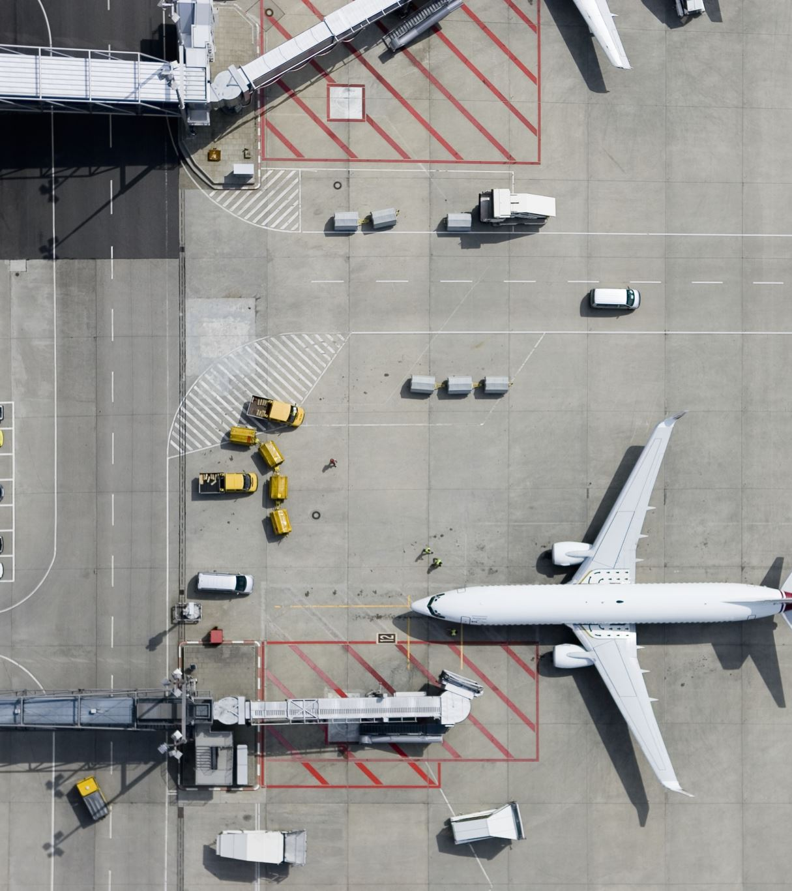
What is our goal?
We are interested in:
Estimating departure and arrival delay rate of airplanes taking off in the NYC area.
*Delay is defined as when the arrival/departure time is 15 minutes later than scheduled

Slide 3
Why are we interested in this topic?
As residents of the east coast, many of us travel through NYC airports.
Knowing departure delay rate of flights, and a brief distribution of it will be helpful for us to make better schedule or avoid flight delays affecting subsequent travel plans.
What variables are highly correlated with departure/arrival delay rate of flight from NYC?
Location?
Date?
Time period?
Airline?

Slide 4

What do we use to analyze?
We use nycflights23 package preloaded in R.
This package contains several datasets describing situations of 3 airports located in NYC in 2023 from different perspective, such as airline, airport.
Only dataset flights which contains specific information of each flight taken off from NYC airports will be used.

Slide 5
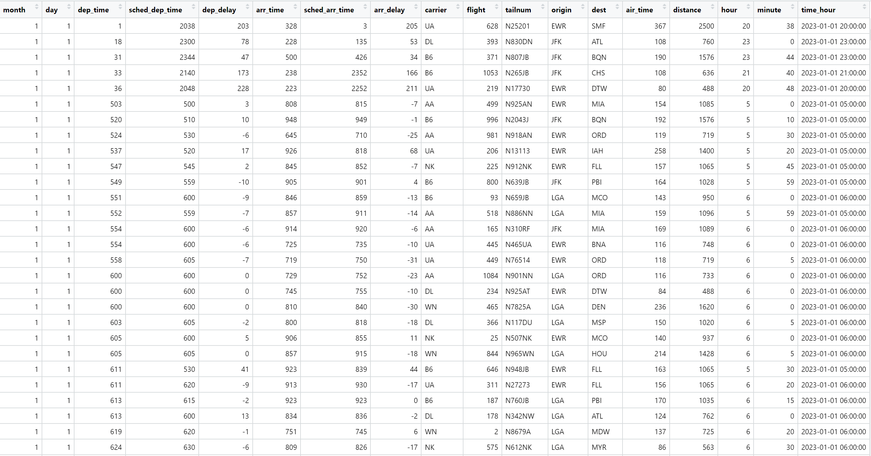

Slide 6


What are we doing / What do we plan to do?
Clean and tidy the NYC flights dataset to make it analysis-ready.
1
Create summary tables showing departure and arrival delay rates for each airport.
2
Produce visualizations like barplot and scatterplot to reveal delay patterns and relationships.
3
Identify factors that influence delays and compare performance across airports.
4
Practice collaborative data analysis and communication as a team.
5

Slide 7
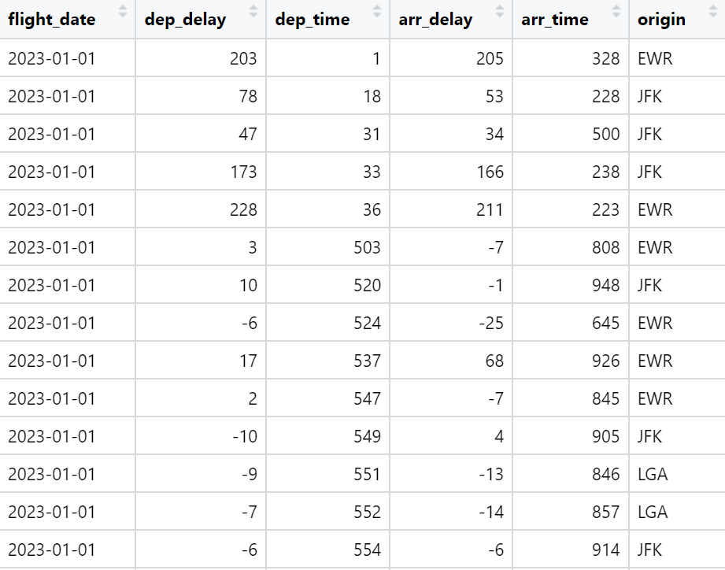
Kept variables for analysis
flight_date: when?
dep_delay & arr_delay:
=(actual departure-scheduled departure) in minutes
dep_time & arr_time: might help seeing whether flight delays are concentrated in a certain period of time
origin: where?

Slide 8
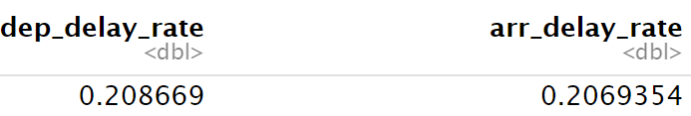
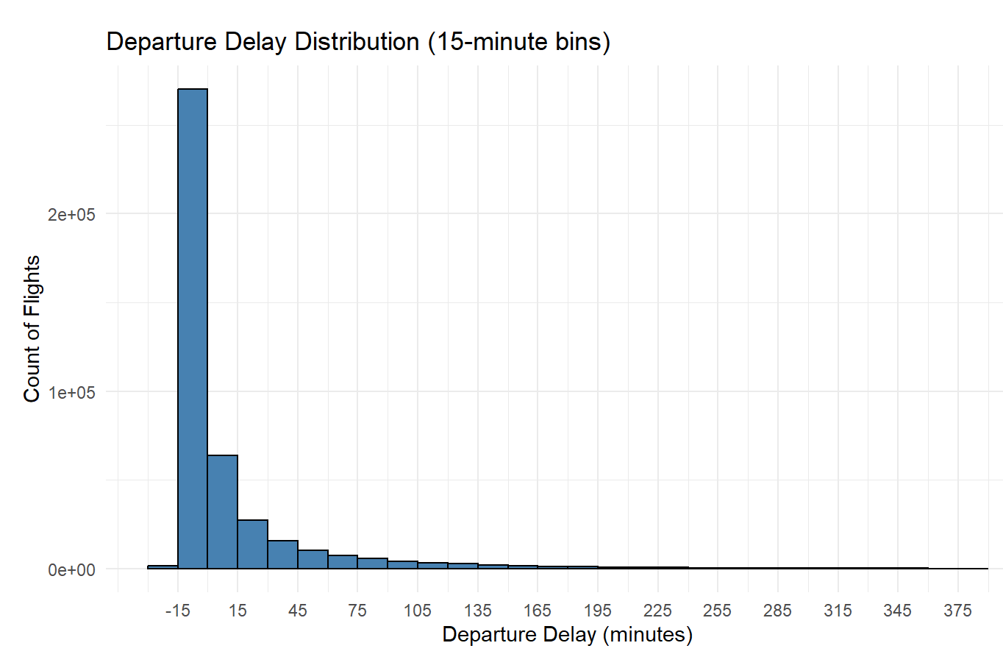
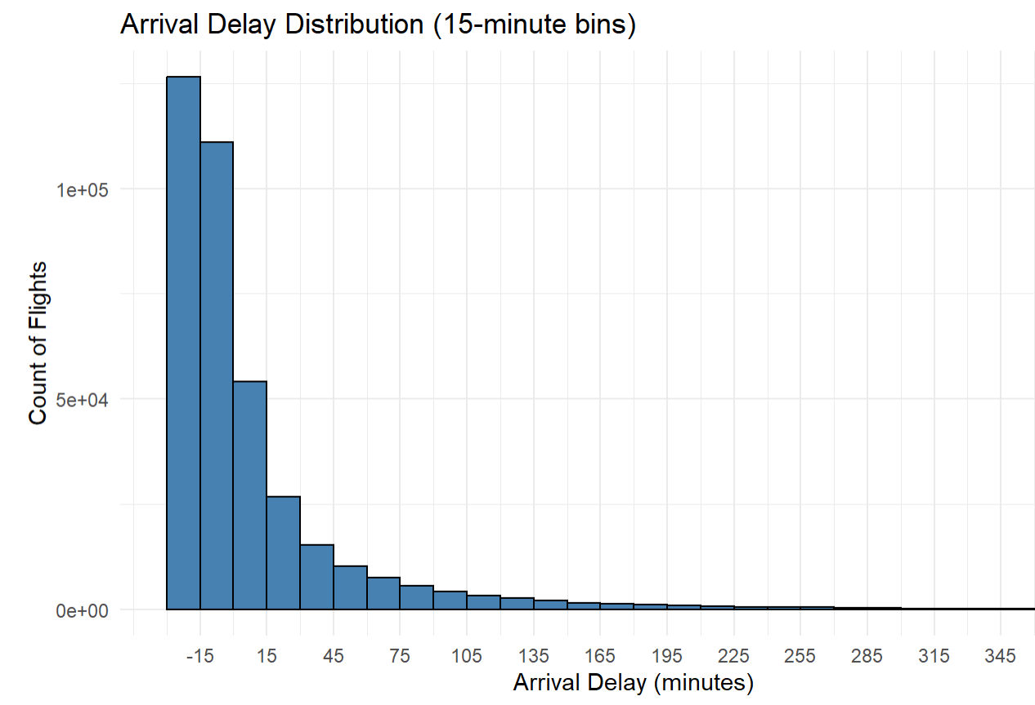
Any fun facts so far?
Yes!

Slide 9



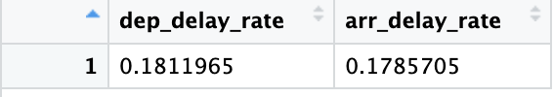
Current Findings
Overall Delay Rates Across Three Airports:
Delay Rates at the JFK Airport:
Delay Rates at the LGA Airport:
Delay Rates at the EWR Airport:

Slide 10
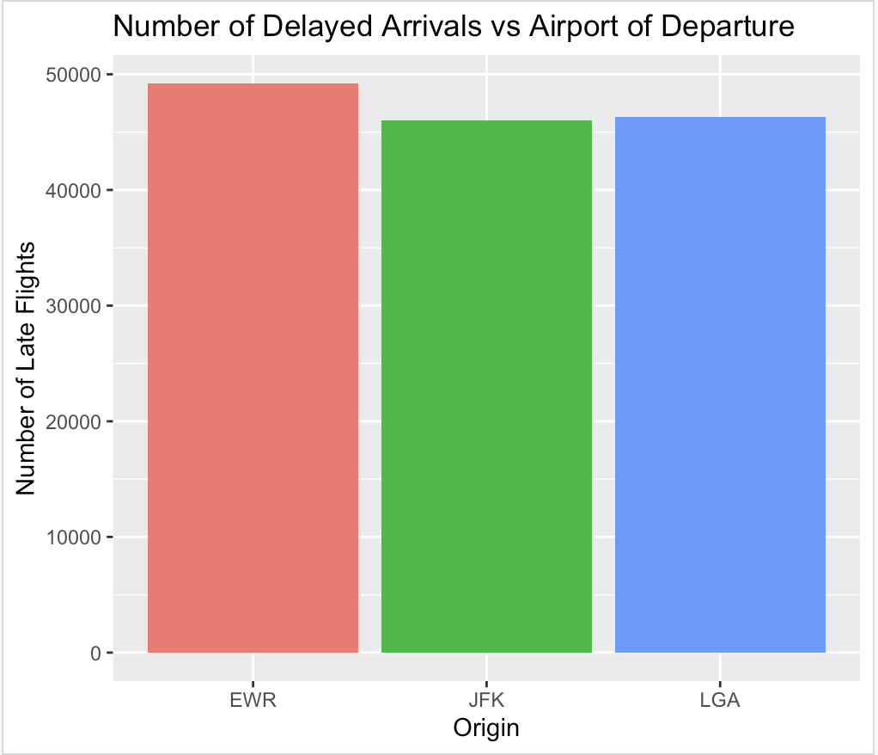
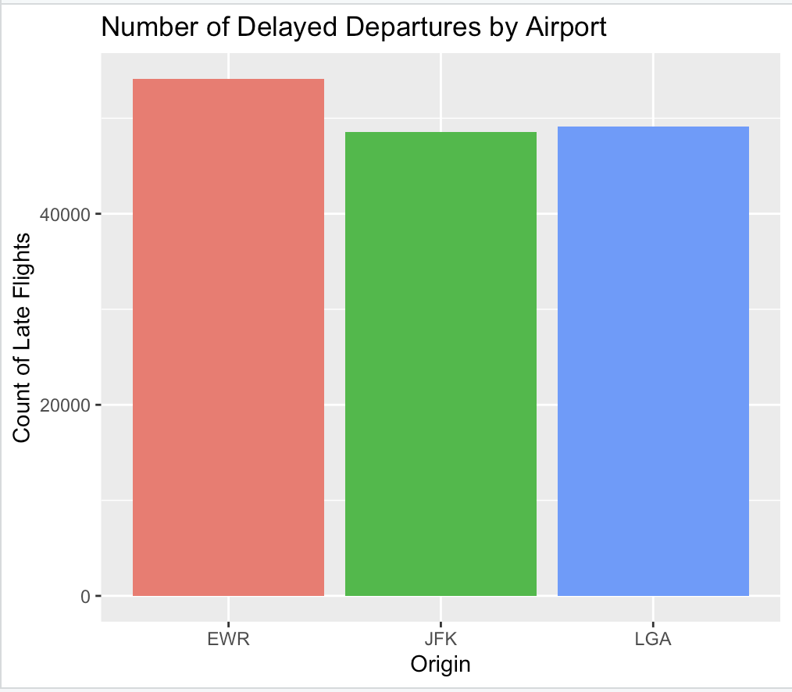
Barplot

Slide 11
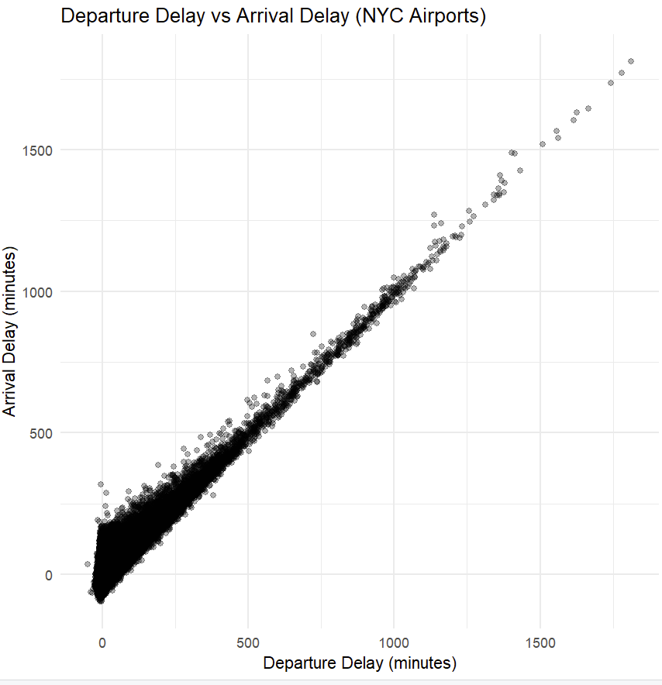
Scatterplot
This scatterplot shows the relationship between departure delay and arrival delay for all flights leaving NYC airports in 2023. Each point represents a single flight. The plot reveals a strong positive correlation: flights that depart late almost always arrive late as well. Most flights cluster within the first 200 minutes of delay, but some extreme outliers show very long delays. Overall, the pattern suggests that departure delay is a strong predictor of arrival delay.

Slide 12
Challenges we meet so far?
Handling missing or incomplete departure and arrival time values from the dataset.
Converting time variables into a consistent and usable format
Converting the raw time columns into proper R datetime formats and handling missing values without losing important observations
Combining wrangling steps correctly to avoid introducing errors in summaries.
Communicating changes clearly when someone modified the code or cleaned the data.
Ensuring that the data we are displaying is insightful so that even individuals who aren’t aware of this subject can extract meaning from it.

Slide 13
What improvements we might make if got time?
• Analyze weather data like temperature, wind alongside flight delays for deeper insights. • Compare delay patterns across seasons or holidays. • Build a simple predictive model to estimate delay probability. • Include airline-level comparison dashboards for clearer insights. • Add interactive visualizations using 'plotly' or 'shiny' for better storytelling. • Incorporate additional datasets from the package (airports, airlines, planes) to create more detailed breakdowns.
Detect if there is trend in delays between different airlines.

Slide 14
Thank you!

